Slide 1


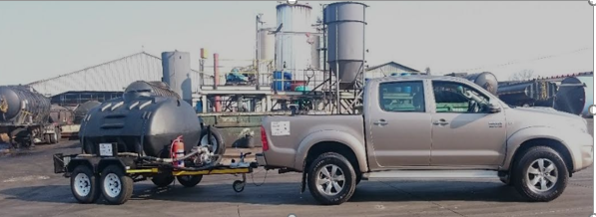


SAFEGUARDING OUR ENVIRONMENT
HOME ORGANISATION CONTACT - 0727129248 / 0838352801
Website:www.bbmjuoc.com
Email: BMMJ@gmail.co.za

Slide 2

SAFEGUARDING OUR ENVIRNMENT
HOME ORGANISATION CONTACT- 0727129248 / 0838352801

Slide 3
COMPANY SUMMARY
BMMJ is a ISO 14001 certified company committed to safe and sound environmental management. The business was established in 2016, started by 4 sisters and 1 experienced used oil collection partner. We saw the need in our communities to dispose of used oil safely to support the fight against global warming and lend a hand in promoting and taking care of our environment for our future generations. We realised that in our communities there are a number of informal vehicle repair shops and mechanics that were not informed or aware of how to safely dispose of the used oil they generated.
We therefore embarked on a journey to supply them with containers, 210L drums / BLC, jojo tanks to decant used oil into for us to collect and safely dispose of once full. We also service our mines and car dealerships around the country by safely collecting and safely disposing of used oil. By managing the process of delivering containers and tracking their volumes for collection at competitive prices we save our clients their time and money to manage more important day to day business matters without worrying about the waste they generate and this becomes a win- win situation for both parties and most importantly our environment for future generations.
Keeping our environment at its optimum performance requires that its kept clean and safe for nature to take its course the way it is meant to. Our part is to ensure that the eco system of oil just like nature evolves into its completion from being generated, to safe collection, handling, protected transportation to safe delivery to its destination. The oil is delivered to accredited recyclers and refiners around the country.

Slide 4
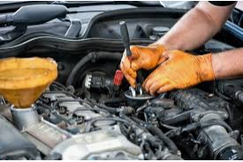

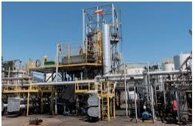

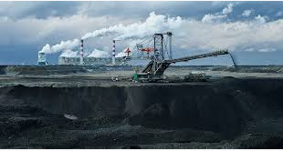
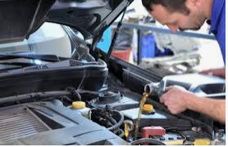
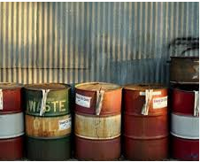
OUR CLIENTS

Slide 5
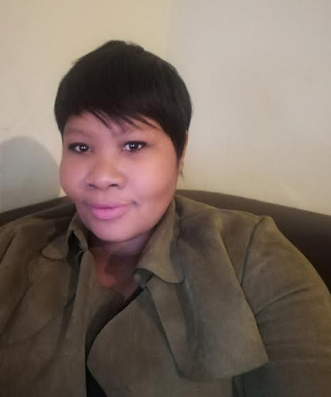
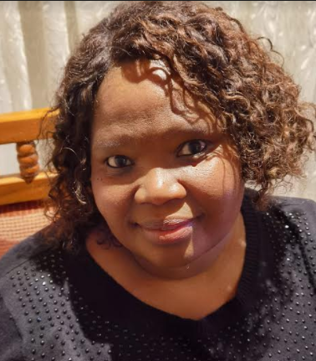


MEET THE TEAM
Clock-wise
Managing Director: Mmakhotso Dube
Chief Executive Officer:Vusi Buthelezi
Sales Manager: Joy Lenake
Chief Financial Officer: Mamotse Lenake
Business Manager: Banini Lenake

Slide 6




MISSION To promote the safety of our environment by safely collecting and disposing of used oil at competitive prices coupled with efficient service.
VALUES
To create value added service for our clients by saving them time in managing their waste product value chain, Collecting oil and disposing of safely.
VISION
To offer efficient services to our clients by continually safely collecting used oil and safely disposing of it as per the waste management procedures in ensuring that our environment is preserved for our future generations.

Slide 7
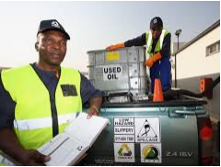
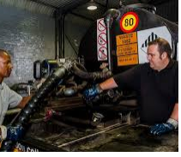
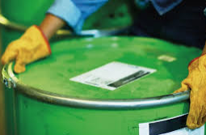
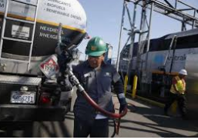
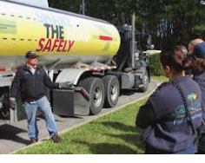
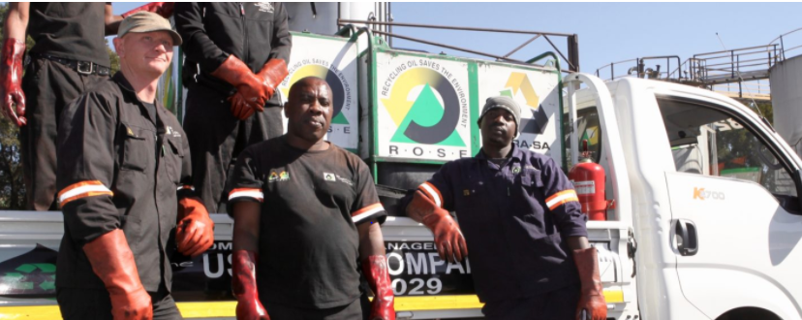
VALUES
WASTE MANAGEMENT PARTNERS
EFFICIENT SERVICE
SAFE ENVIRONMENT

Slide 8
BUSINESS COMEPTITIVENESS
We are in the industrial Westrand area of Gauteng and we service clients around the country.
Offer pro-active services for your used oil collection needs and only deliver to ISO 14001 registered refiners and recyclers around the country.
We are overseen and audited by NORA-SA and make data reports available as an additional requirement of the Waste Act.
Offer a value- added collection service with containers provided to customers to decant oil for collection.
We also have Public Liability Coverage of R1 000 000 and Spillage insurance.
For yours and our peace of mind we only hire fully trained staff and pay market related prices for your used oil.

Slide 9
What Our Customers Are Saying
Best service ever received. They drop empty drums for me weekly and collect them when full timeously, I do not even have to get involved in this process as long as I know the drums are clean we continue with our day to day without worrying about the task of making sure the oil is collected. All reports and collection certificates are left on every collection and we file them. They manage that part of our business as “ waste management partners”
Gloria Sithole
CEO Brian Motors

Slide 10



LOGGO GALLERY

Slide 11

TABLE OF CONTENTS
1. Cover Page
2. Company Summary
3. Company History
4. Our Clients
5. The Team
6. Mission, Vision, Vales
7. Company Competitiveness
8. Client Testimonial
9. Loggo Gallery
10. Table of Contents

Slide 12
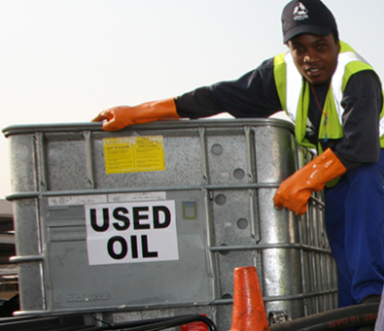
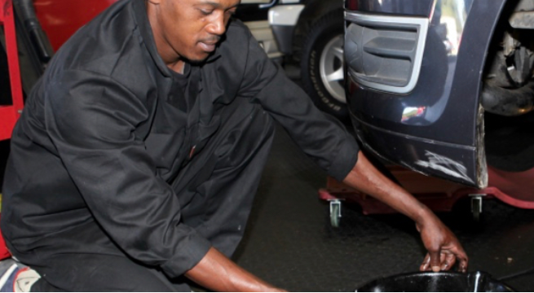
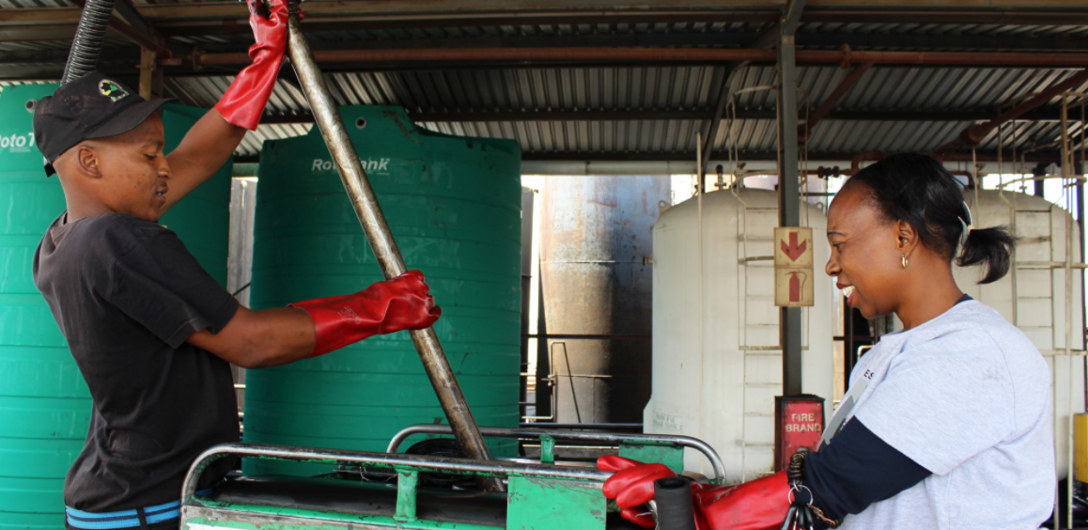
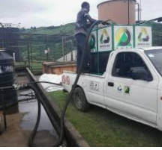
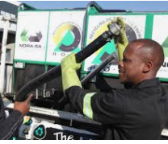
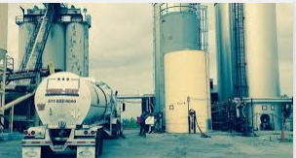
Pics to use on website

